Slide 1
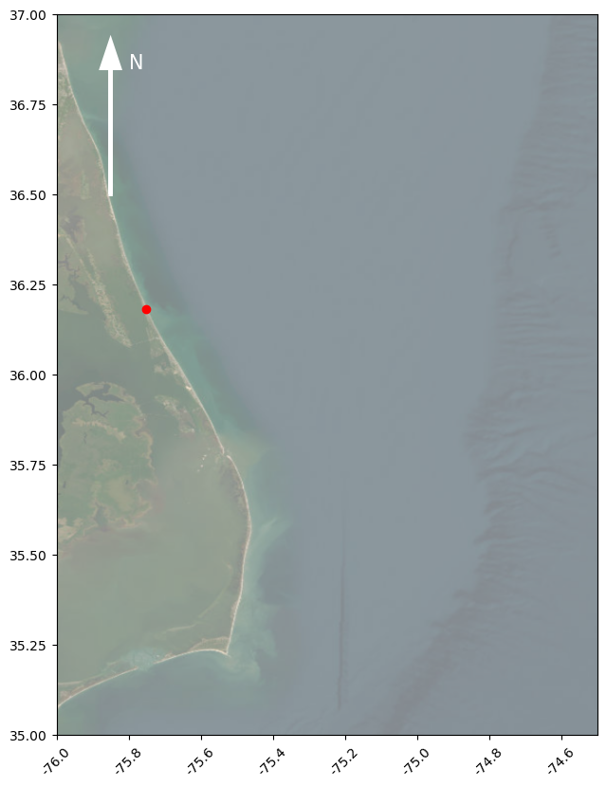
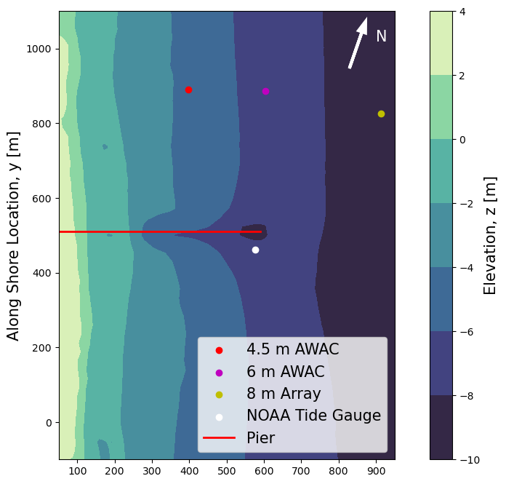
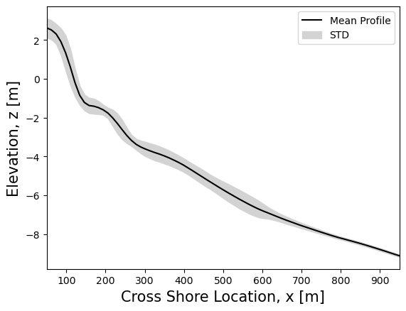
Figure 1 – Location of Field site, fixed instruments and bathymetry
(A)
(B)
Latitude [°N]
(C)
Longitude [°E]

Slide 2
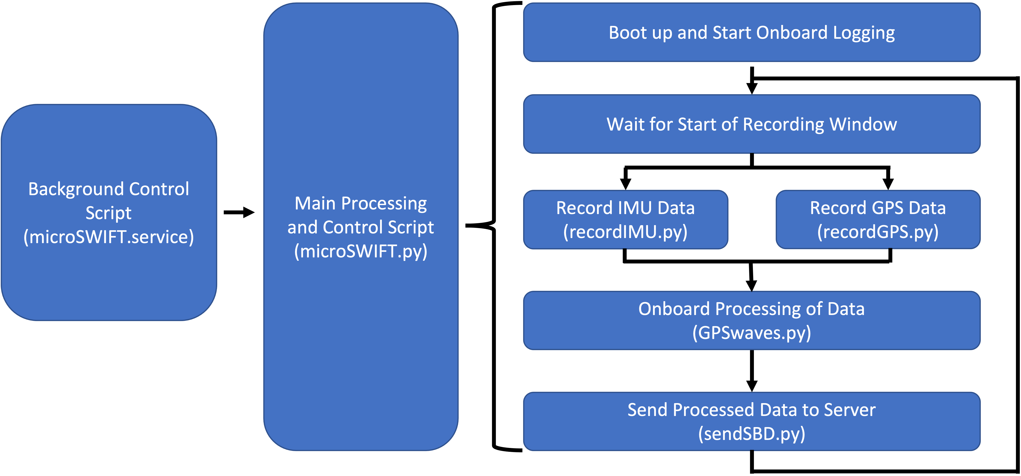

Slide 3
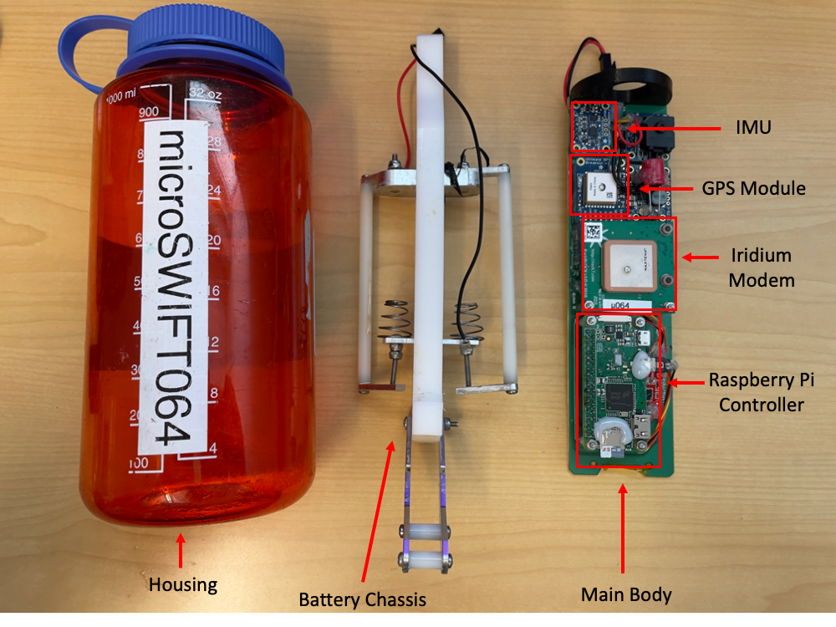

Slide 4
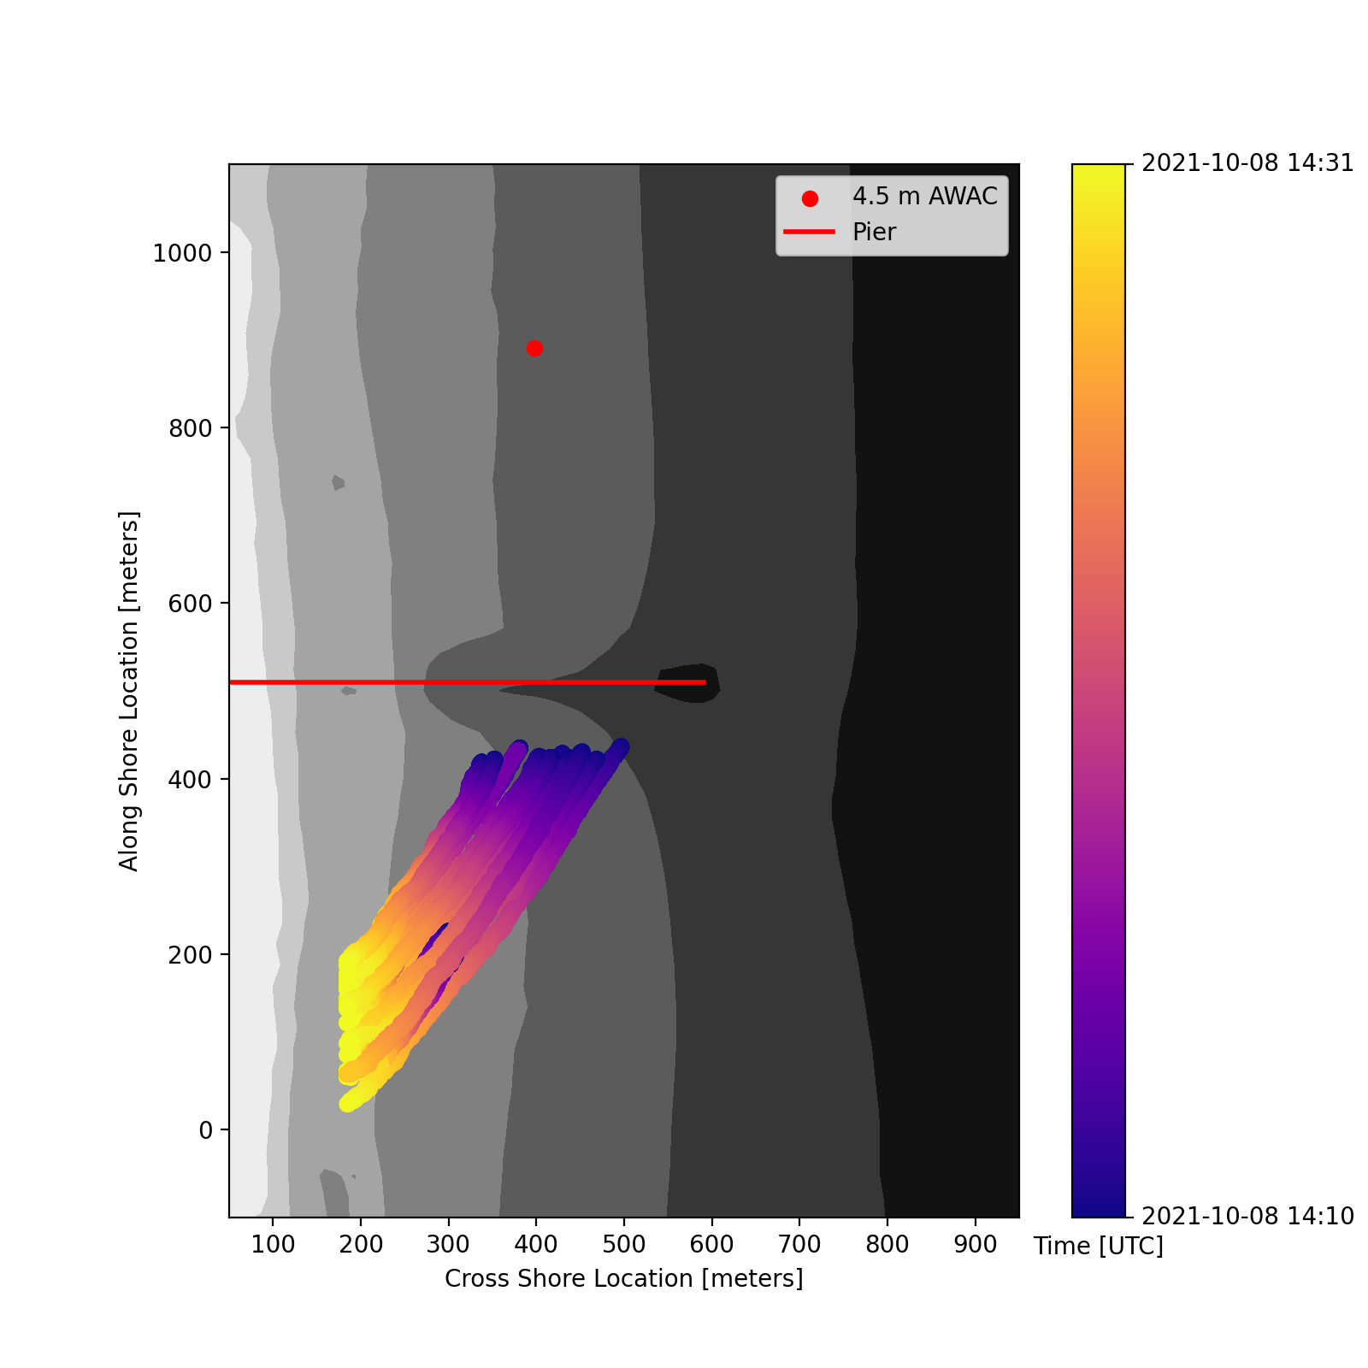
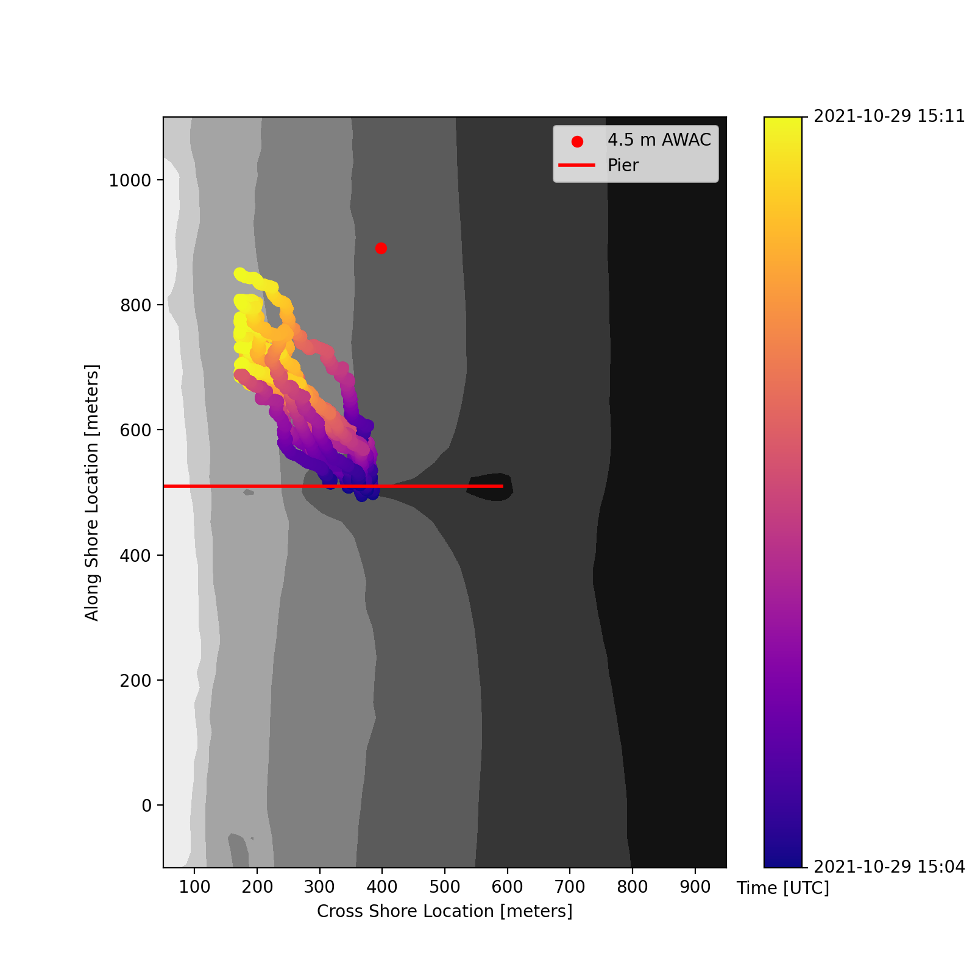
(A)
(B)
-4 meters
-6 meters
-8 meters
-4 meters
-6 meters
-8 meters

Slide 5
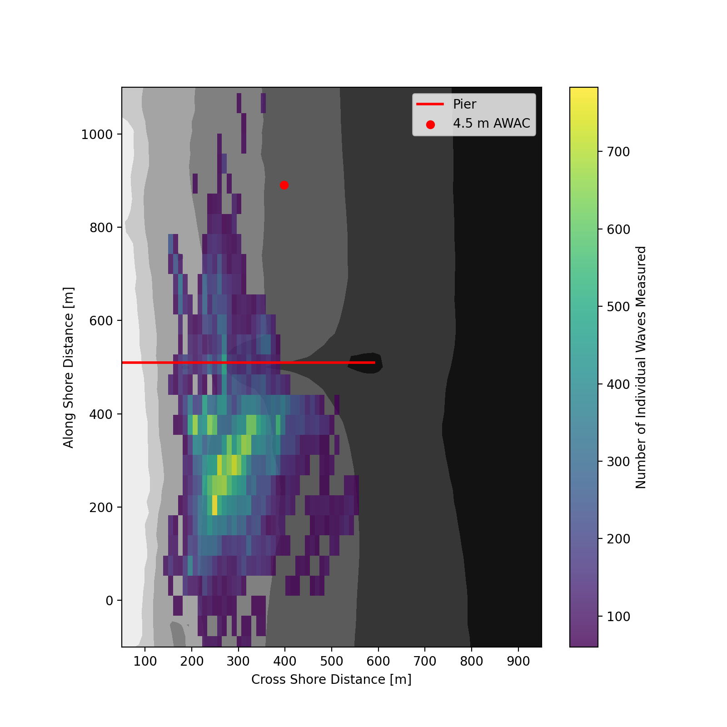
Density of Individual Waves Measured
-4 meters
-6 meters
-8 meters

Slide 6
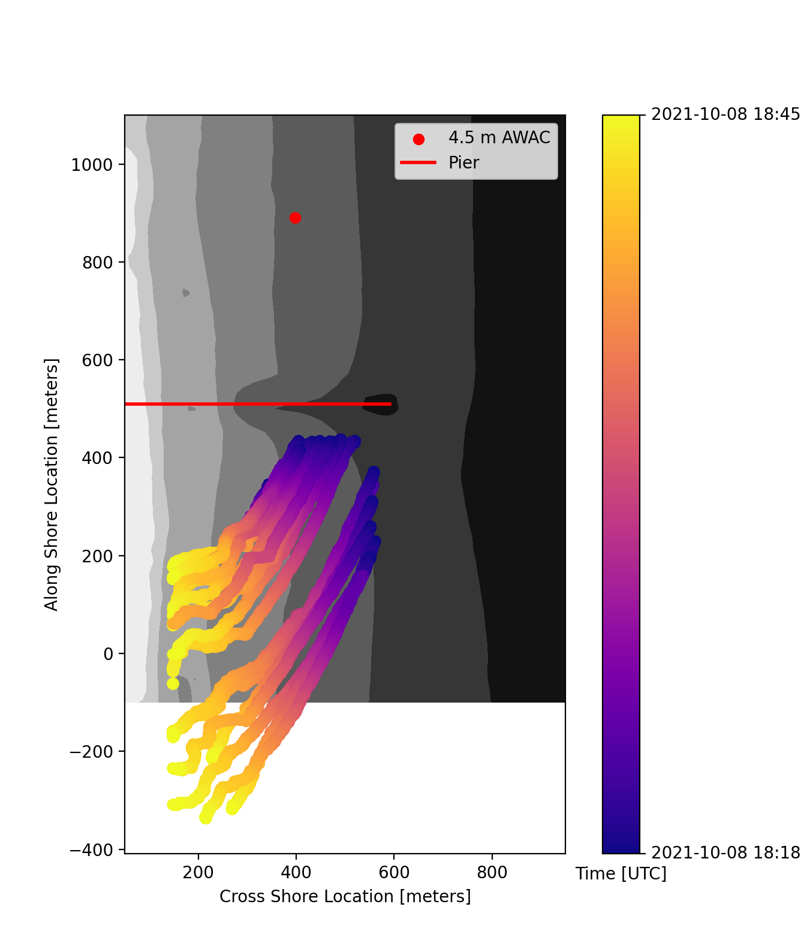
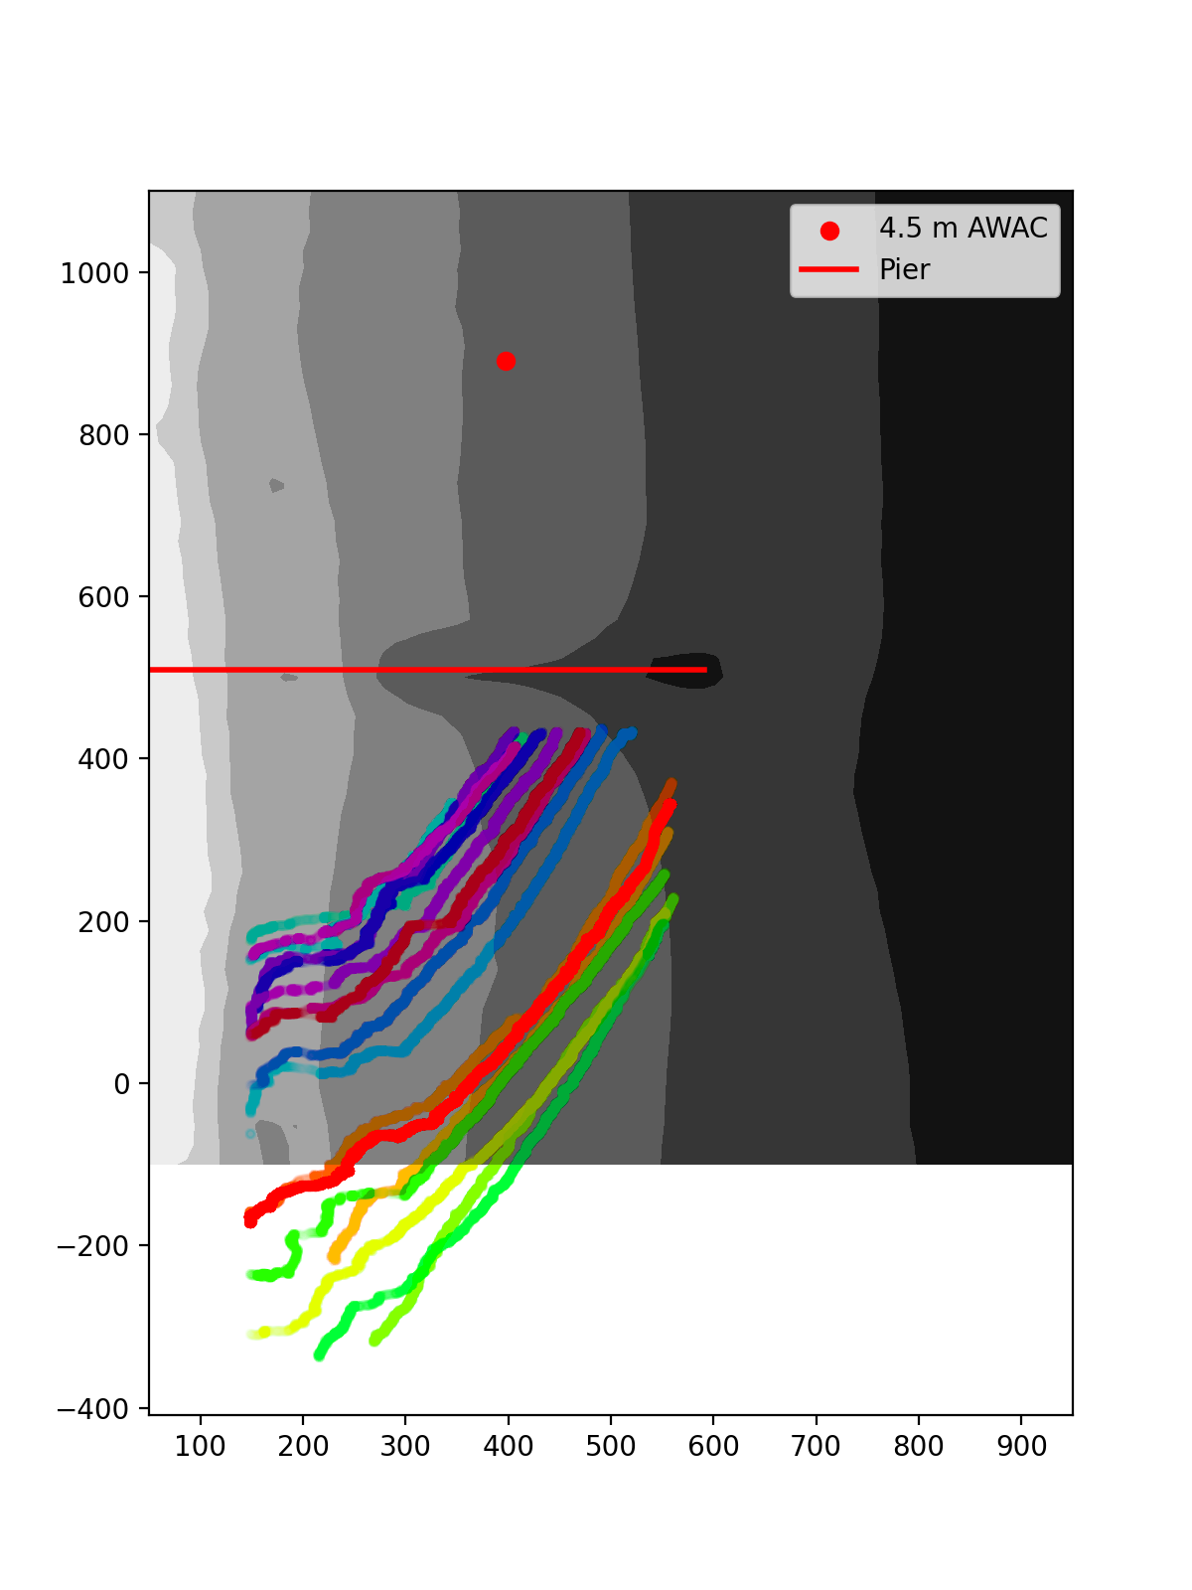
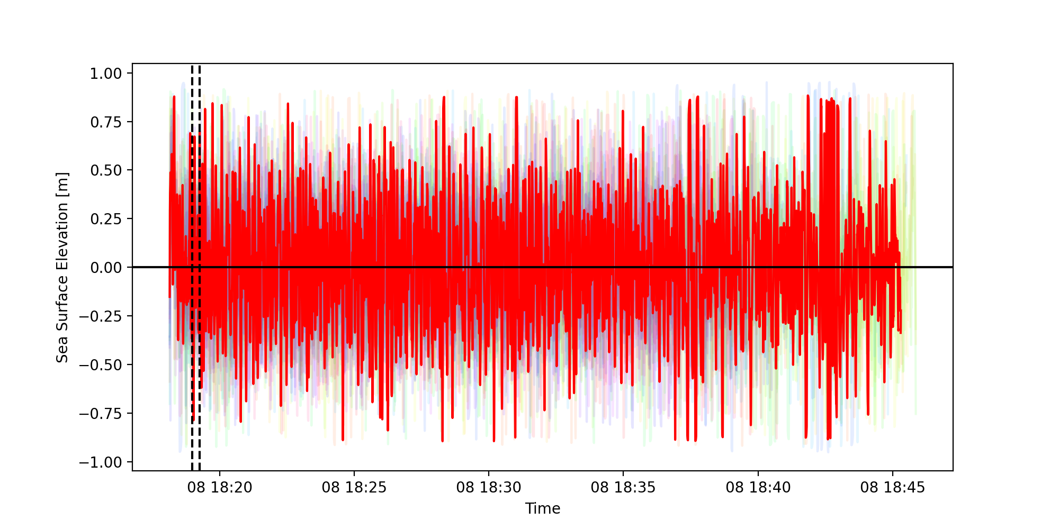
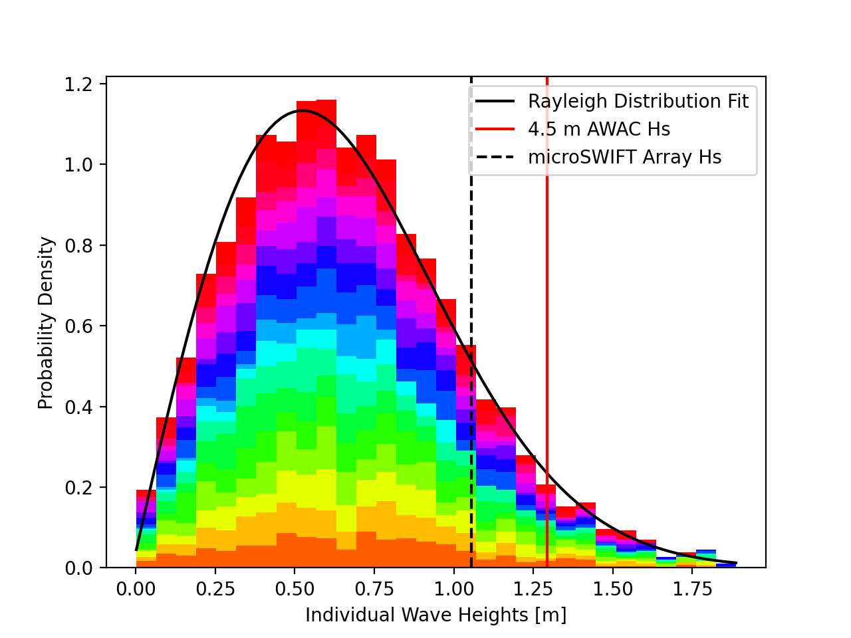
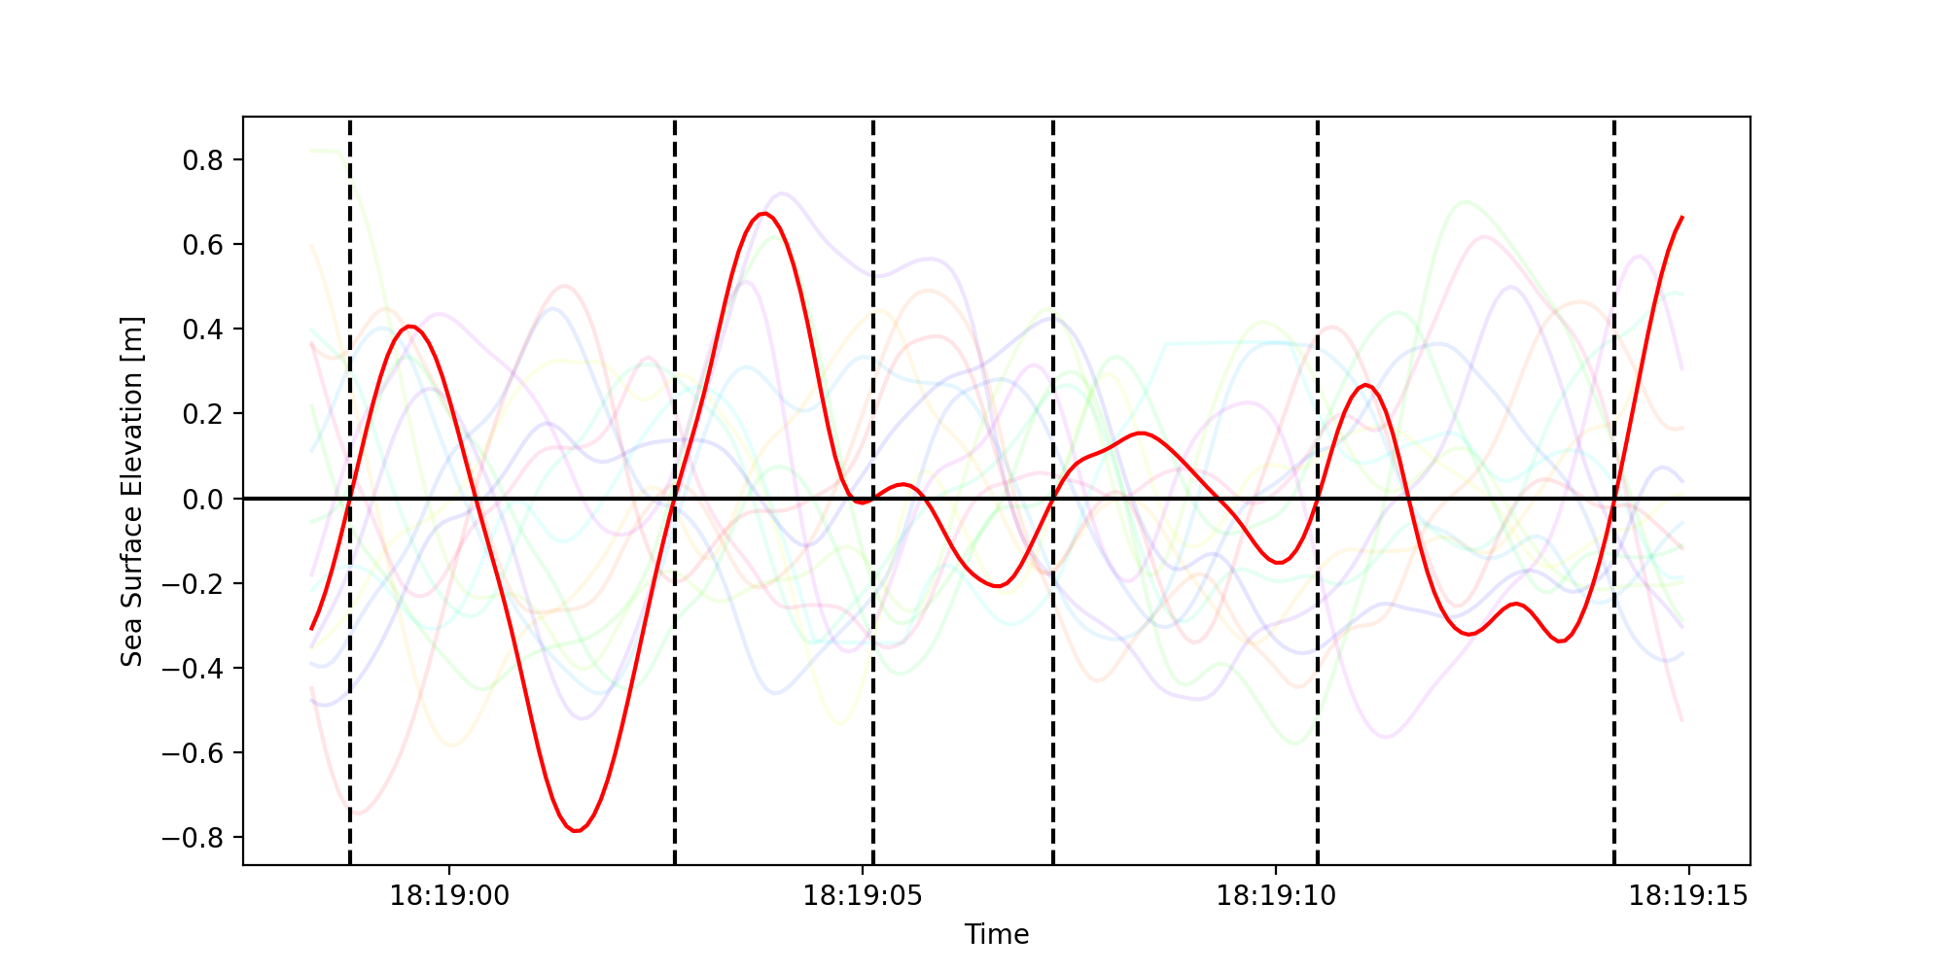
Mission Processing Steps
(A)
(B)
-4 meters
-8 meters
-4 meters
-6 meters
-8 meters
-6 meters
(C)
(E)
Individual Wave Height
(D)
4613 Individual Waves in Mission

Slide 7
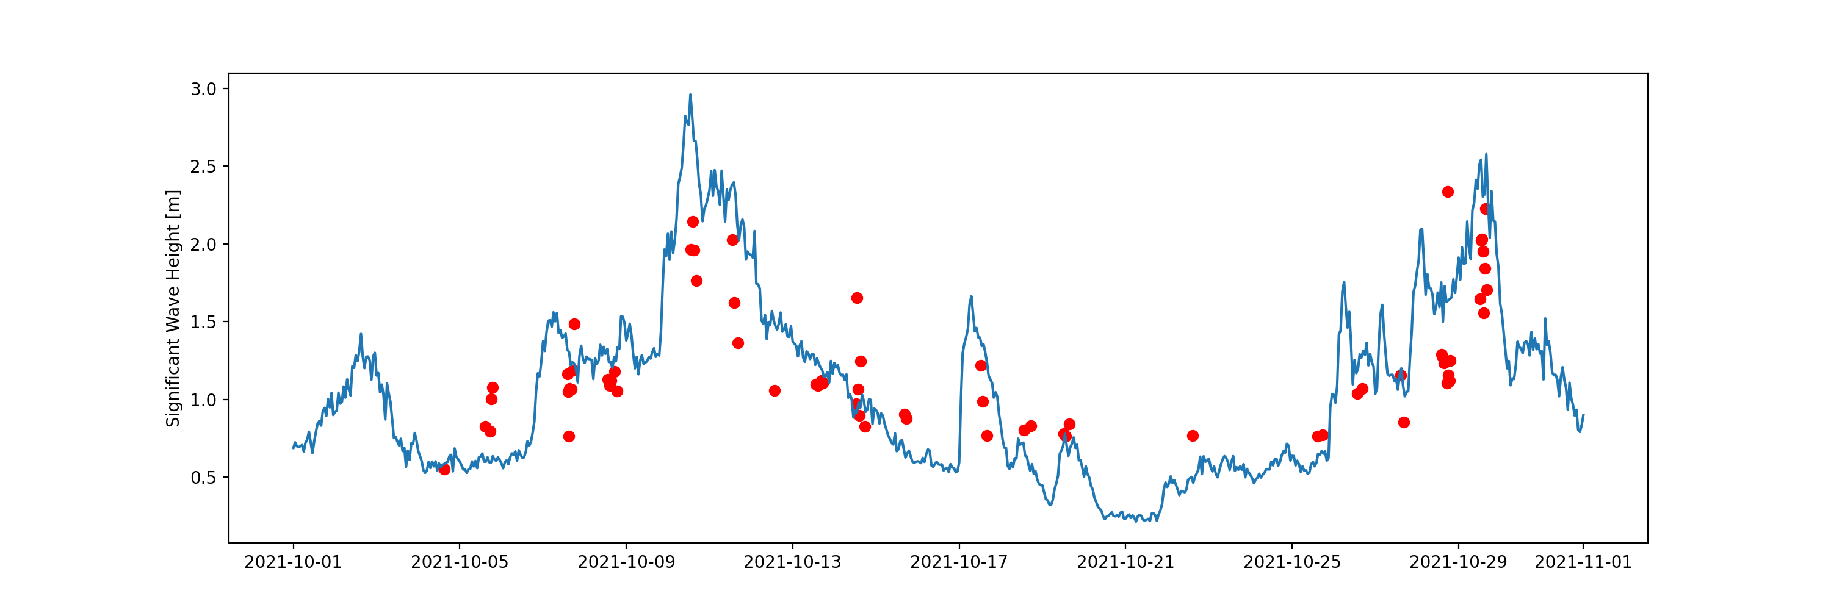
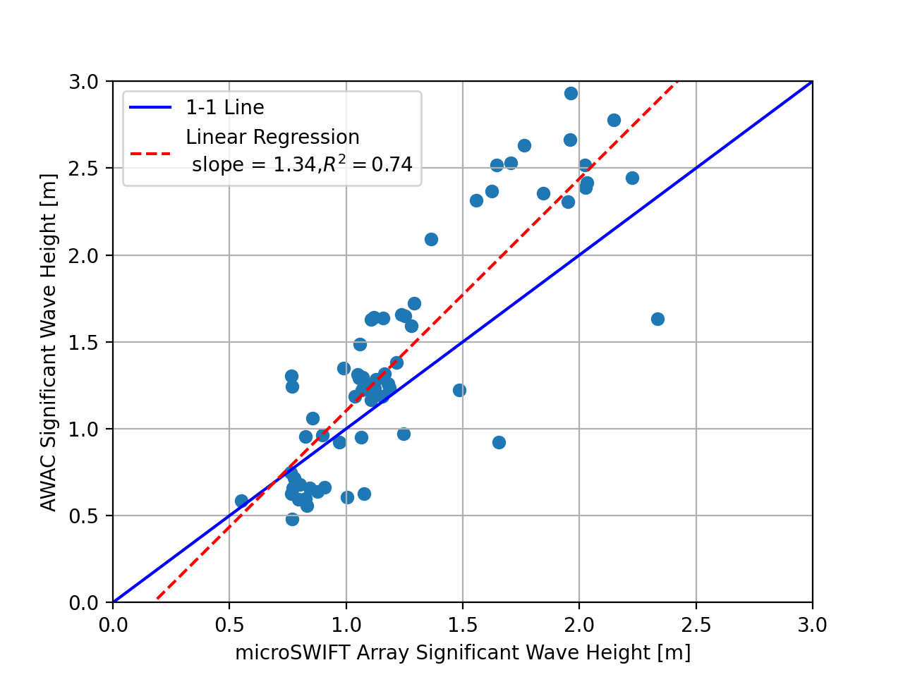
Comparison of All waves in all depths

Slide 8
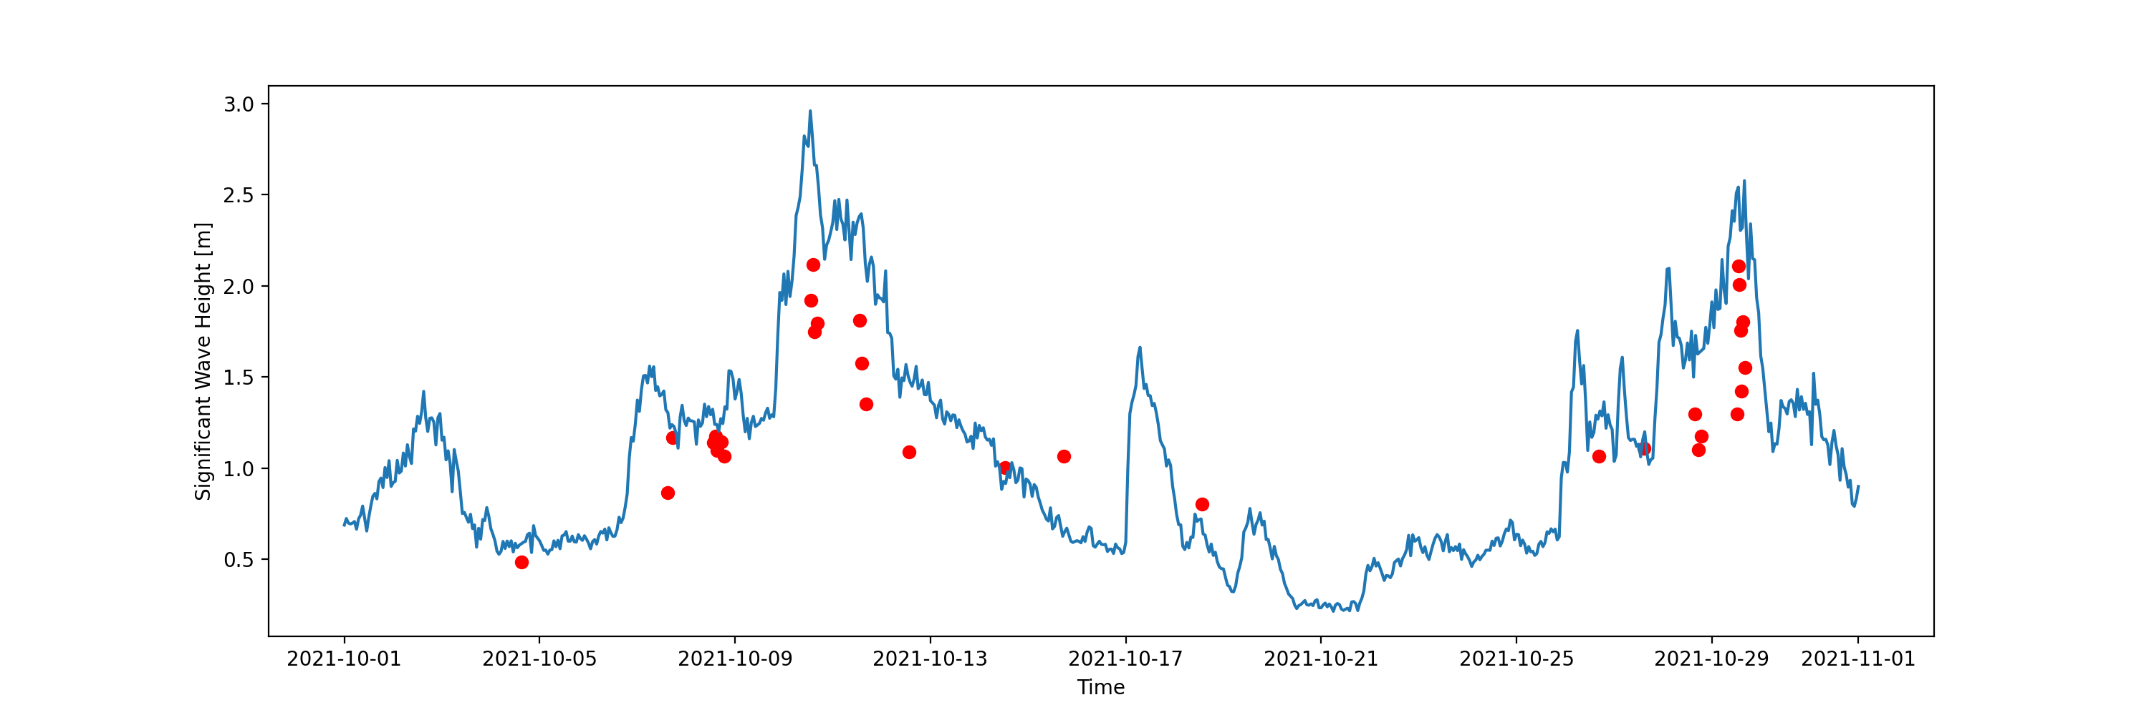
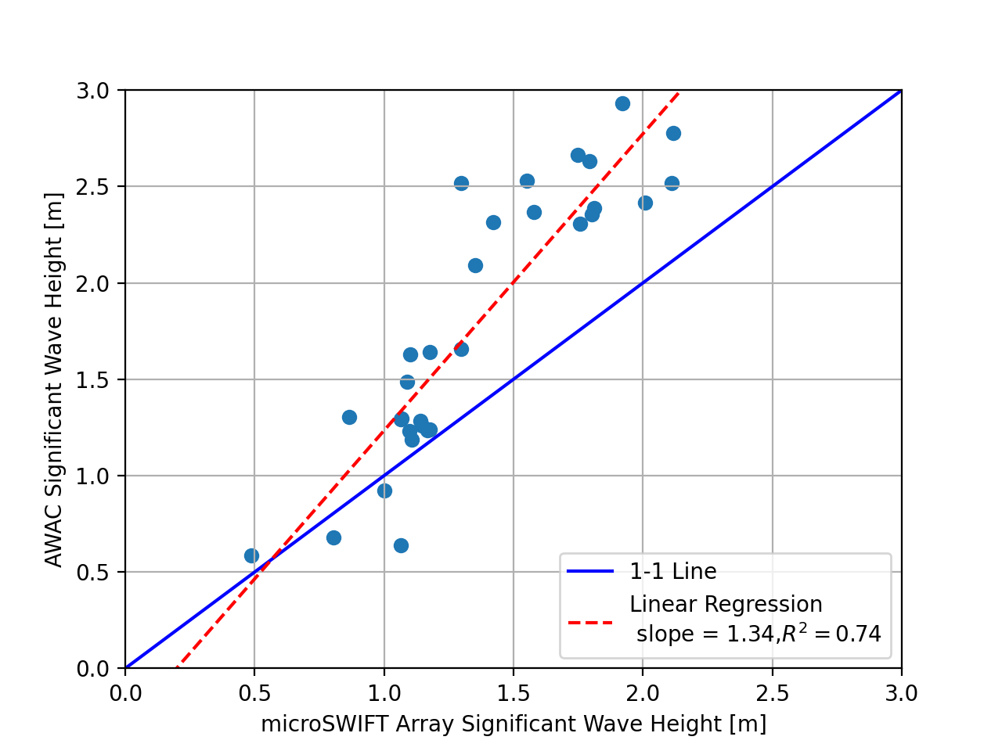
Comparison of only waves 4-5 meters

